Slide 1
Software Engineering
Lectures :
Tuesday 08.00-10.00 am
Thursday 08.00 -10.00 am
By Alex Tumwesigye
atumwesigye@gmail.com, +256774149775

Slide 2
Assessment
Two tests: 10% each
CAT 1:??
CAT 2:??
One project:10%
Home works: 10% (can be transferred to CATS)
Exam: 60%
Attendance at least 75%
NB: Any exam/test malpractices, consider yourself not to have sat for that test.

Slide 3
Objectives of the course
Equip students with the ability to apply software engineering principles and methods of design in the development and maintenance of Telecommunication engineering applications

Slide 4
Content
Software engineering basics and definition
Phases of software development
Software methodologies
Software development teams
Introduction to c++ programming
Functions
Pointers and arrays
Memory (dynamic and static memory)
OOP - Classes and interfaces, abstraction, inheritance, polymorphism, etc
Software engineering applications in Telecommunication Engineering (Project assignment)

Slide 5
Software engineering
Application of engineering principles and methods of design in the production of software
Covers technical aspects of build software systems
Managerial issues e.g directing programming teams, scheduling, planning and budgeting

Slide 6
Phases of software development
Analysis – identify the problem, gather requirements from clients, etc
Design – The layout, etc. Use of requirements to clarify the picture of the software
Implementation – put the design to action –coding (programming)
Testing – test the code and debug to correct errors, maintenance can also be done

Slide 7
Software methodologies
Waterfall
Project is segmented into hierarchy of chunks, phases.
Analysis comes first, then design,implementation and testing
Phases are executed sequentially
Analysis

Slide 8
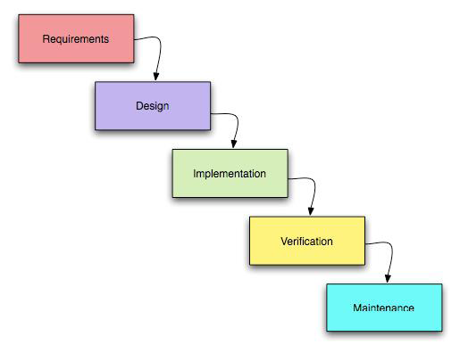
Waterfall

Slide 9
Good concepts of waterfall
Work is done in stages
Content reviews are conducted between
stages, and
Places emphasis on documentation

Slide 10
Critics of waterfall
Impossible to get one phase of the project development perfected
Software development projects must be open to external factors – not the case
Only part of the team are qualified for a certain phase hence “code monkeys – people who programs for a living”

Slide 11
Spiral methodology
Evolution of the waterfall method
Projects are both incremental and interactive
Teams start small and benefit from enlightened trial and error along the way
Chosen for large, extensive complicated projects
Introduces the concept of prototyping

Slide 12
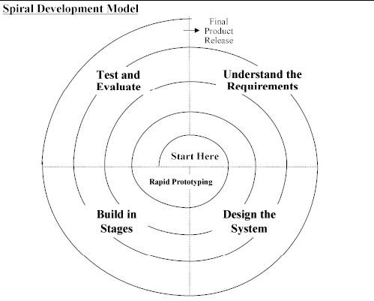
Spiral methodology

Slide 13
Good concepts of spiral
System is able to grow sequentially since it allows feedback in the system development life cycle
Avoids stagnation of the system at a certain phase

Slide 14
Critics of spiral
No control over the oscillations
When will the solution be finally reached?

Slide 15
Prototyping
Building experimental systems in an explanatory way
Advantages
May provide proof of concept
Give users an idea of how the final system will look like
Enables higher output for user
Cost effective

Slide 16
Prototyping
Advantages (cont’d)
Encourages active participation from users and producers
Increase system development speed

Slide 17
Prototyping
Disadvantages
User expectation on the prototype may be above its performance
May cause systems to be unfinished
May cause systems to be implemented before they are finished
Difficult to manage projects
Not suitable for large applications

Slide 18
Software team organization
A team is a cooperative unit.
A software engineering team is a group of people drawn from diverse but related groups, assigned to perform a well defined function for an organization or project.
Can part-time participants or can have other primary responsibilities

Slide 19
Building teams
Depends on
People available
Needs of the project
Needs of the organization
Effective teams consists of people fulfilling a variety of roles. Each person can take one or more roles

Slide 20
Project roles
Analayst
Programmer
Project manager
Homework: Describe other roles other than the above which can be assigned to team members in a software engineering project
Due: Next lecture

Slide 21
Team organization
Horizontal approach – Consists of specialists who take on a specific tasks/role and only that role
Vertical approach – consists of generalists who take on a variety of roles
Hybrid approach – a combination of specialists and generalists

Slide 22
Horizontal approach
Teams work on several use cases simultaneously, each member working on their own aspects of the use case
Good communication required between members
Defined processes and quality gates for specialists are needed
Advantages
  High quality of work on each aspect
  External groups e.g users, operations staff, interact with a small group of specialists who understand their exact needs.

Slide 23
Horizontal approach
Disadvantages
  Specialists do not appreciate the work of other specialists, thus there is disconnect in various aspects of the project.
  Information required by the “back-end” people may not be gathered by the “front-end” people.
  Project management is difficult because of competing priorities, visions & needs of specialists.

Slide 24
Vertical approach
Use cases are assigned to small groups, who implement the different use cases.
Good communication required to avoid implementation of common functionalities
Advantages
  Developers gain a wide range of skills
  Smooth end to end development on an individual use case basis.

Slide 25
Vertical approach
Disadvantages
  Generalists are hard to obtain – high paid consultants
  Generalists do not have special technical expertise required to quickly solve detailed problems
  Subject matter experts may have to work with several groups of developers, increasing their burden
  All generalists are not equal!

Slide 26
Review next lecture
Programming languages (c, c++, PHP/MySQL, Java, perl, Python,etc)
Project 1: Implement a scheduling system for lectures for different departments in the Faculty depending on the available lecture rooms using c or c++ programming, indicate the objectives, justification, scope, methodology, etc. The solution must include functions, classes, inheritance, etc.
Deadline: 2 weeks before the Final exam

